Slide 1
Now 45 minutes !
Learning IT
NUS Cloud Assessment
26th Oct 2022
with bIT bIT
Presenter : Matthew Seow
Leslie Wong
NUS Cloud Policy Team
Learning Objectives:
Know more about NUS Cloud Assessment Process
Learn how to use the NUS Cloud App for submission of Cloud Assessment
The recording and slides will be shared on the Digital Enablement portal below :
https://ss.nus.edu.sg/digital-enablement/learning-it-with-bitbit/past-learning-it-with-bitbit/
Notes:
Good afternoon, thank you for joining this session of Learning IT with bITbIT. My name is Matthew and my colleague, Leslie are going to share with you the NUS Cloud Assessment Process. And also to learn how to use the cloud app for submission of cloud request (such as new cloud assessment request or re-assessment request) and the registration of assessed cloud solutions. Ready? Let’s go.

Slide 2
NUS Cloud Assessment
Agenda
What is Cloud Assessment?
Why? When? How?
The Cloud Assessment Decision Flow
Assessed Cloud Routing and Approval Process
Full Cloud Assessment Request
Full Cloud Assessment Routing and Approval Process
How to use nCloudAssess Application
FAQ + Q&A
Notes:
Hi. A big welcome for joining this session of Learning IT with bITbIT.
Today agenda are as follow: (1) NUS Cloud Assessment Requirement ; (2) A quick intro to the routing and approval processes of cloud assessment ; (3) a demo of using the nCloudAssess app for submission of cloud assessment as well as registration of assessed cloud solutions ; (4) lastly, Q&A
We would like to get your feedback towards the end of the presentation.

Slide 3
NUS
Cloud
Assessment
Notes:
Welcome to NUS Cloud Assessment

Slide 4
Chapter 1
What is Cloud Assessment?
Notes:
What is Cloud Assessment?

Slide 5
What is Cloud Assessment?
Cloud Service Provider Review
Department Review
Cloud Assessment =
+
Business & Legal Risk
Internal Personal Data Management Process
Technical Platform
Personal Data / Privacy Compliance
(Department)
(ORMC)
(NUS IT)
(ORMC)
Notes:
Cloud assessment comprises of two main reviews: [CLICK] the Cloud Service Provider review which focuses on its technical platform and personal data/privacy compliance, [CLICK] and that of Department on its business and legal risk and internal personal data management process. [CLICK] The former is conducted by both NUS IT and ORMC, [CLICK] and the latter by Department and ORMC.

Slide 6
What is Assessed Cloud?
Cloud Service Provider Review
Department Review
Cloud Assessment =
+
NOTE
Business & Legal Risk
Internal Personal Data Management Process
Technical Platform
Personal Data / Privacy Compliance
Cloud Service A
approved for
NUS Restricted Data
(Department)
(ORMC)
(NUS IT)
(ORMC)
Cloud Service A
approved for
NUS Confidential Data
Approved
Notes:
What is Assessed Cloud?
Assessed cloud [CLICK] is a cloud service where the cloud service provider’s technical platform and personal data/privacy compliance have been reviewed and approved by NUS IT and ORMC respectively.
This is also the reason why it is simpler and the duration is shorter for assessed cloud assessments, as only the Department Review needs to be done.
[CLICK] A point to note is an assessed cloud is defined by 2 factors, first, the cloud service itself, and second, the data classification that was approved for the cloud service. Hence, if a cloud service A has been approved for NUS Restricted Data, it does not mean that it has been approved for NUS Confidential Data too, and a new full cloud assessment request will have to be submitted.

Slide 7
Chapter 2
Why? When? How?
Notes:
The “Why? When? How?” around cloud assessment.

Slide 8
Why? When? How?
Why is Cloud Assessment required?
To safeguard NUS data that is hosted/managed in the cloud.
When is a Cloud Assessment submission required?
Before you subscribe/purchase a cloud service. Renewals included.
How do I submit a Cloud Assessment request?
You may use the NUS nCloudAssess to submit the cloud assessment request.
Notes:
Why is Cloud Assessment required?
The answer is simple - to safeguard NUS data that is hosted and managed in the cloud
When is a Cloud Assessment submission required?
Before a subscription or procurement of a cloud service that manages NUS data. This includes renewal of cloud services too.
How do I submit a Cloud Assessment request?
You may do so via the NUS nCloudAssess app.

Slide 9
Chapter 3
The Cloud Assessment Decision Flow
Notes:
The Cloud Assessment Decision Flow

Slide 10
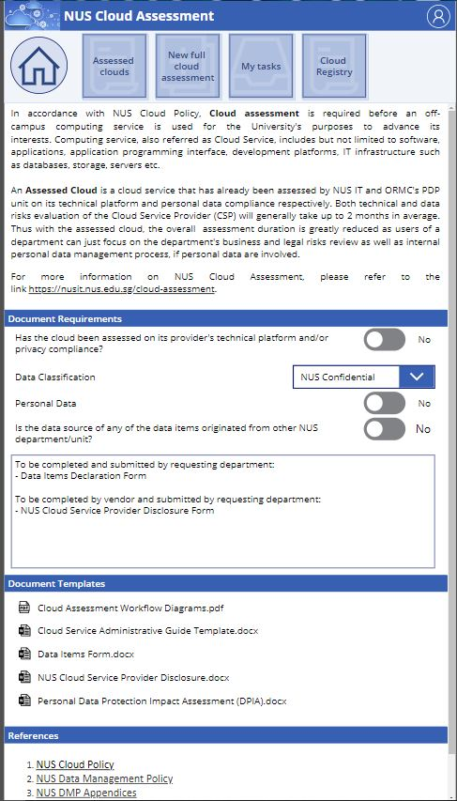
The Cloud Assessment Decision Flow
Department Review Only
Yes
Assessed Cloud Assessment
nCloudAssess App
Found one Assessed Cloud that meets requirements?
Cloud Service Provider Review
+
Department Review
No
Full Cloud Assessment
Notes:
The first step to do when there is an intention to subscribe to a cloud service is to refer to the Assessed Cloud inventory in the nCloudAssess App.
If you can find one service that meets your requirements and it has been approved for your intended data classification too, congratulations, as you may proceed with the simpler and shorter assessed cloud assessment.
If not, a full cloud assessment is required.

Slide 11
Chapter 4
Assessed Cloud Routing and Approval Process
Notes:
The assessed cloud assessment is simple, so we can skip the request submission process and go straight to the routing and approval process.

Slide 12
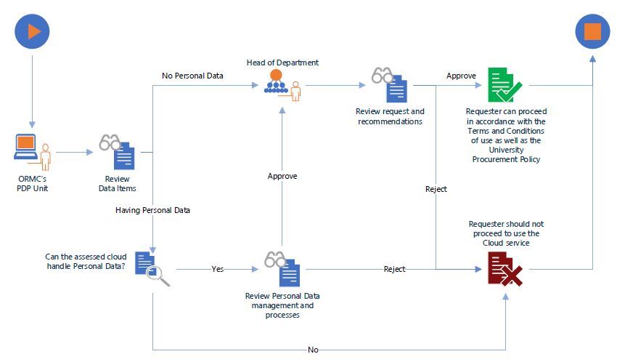
Assessed Cloud Routing and Approval Process
Assessment of an Assessed Cloud
Notes:
After an assessed cloud assessment request is submitted, [CLICK], it is routed to the ORMC’s PDP Unit (a.k.a. the DPO). [CLICK] PDP reviews the request and the data items declared.
[CLICK] If PDP confirms there is “No Personal Data”, the request is routed to the HoD for approval.
[CLICK] [CLICK] If “Personal Data” is involved, PDP further reviews whether the cloud service is appropriate to manage personal data.
[CLICK] If yes, the request is routed to the HoD for approval. If approved, the requestor is notified of the successful assessment and may proceed in accordance with the NUS defined Terms & Conditions of use as well as the University Procurement Policy.
[CLICK] [CLICK] If either PDP or HoD rejects the cloud assessment, the requestor is notified of the unsuccessful assessment.
This concludes the topic on assessed cloud assessment. Let’s move on to full cloud assessment.

Slide 13
Chapter 5
Full Cloud Assessment Request
Notes:
The full cloud assessment request

Slide 14
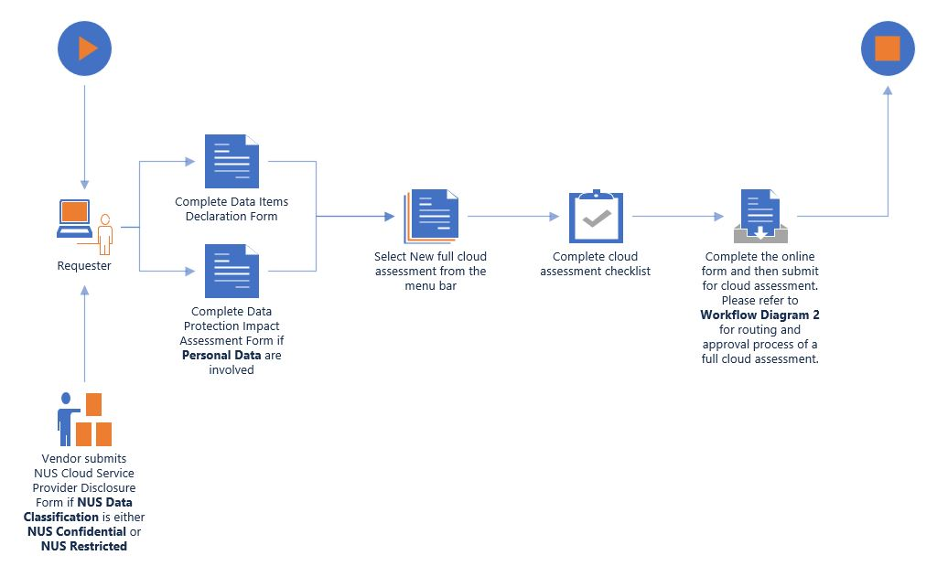
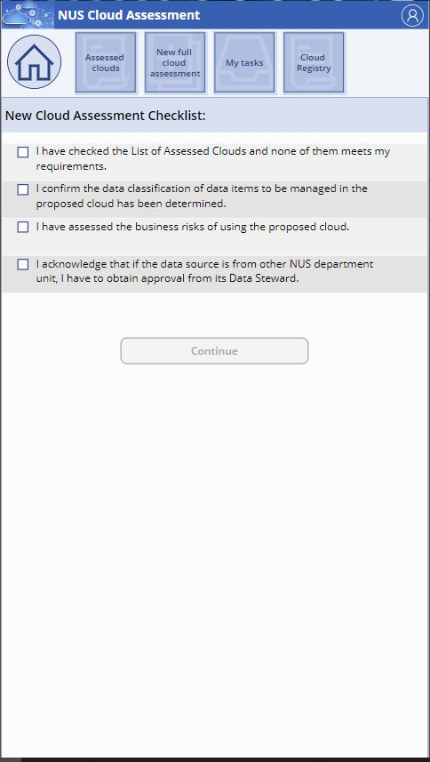
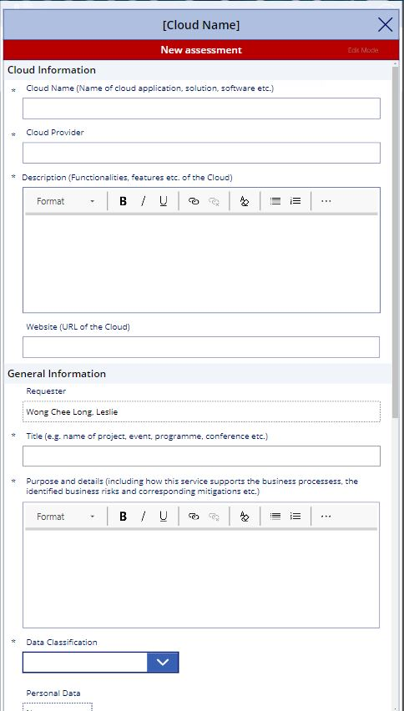
Full Cloud Assessment Request
Submission of new cloud assessment (re-assessment) request with
different data classification:
NUS Confidential with Personal Data
NUS Confidential without Personal Data
NUS Restricted
Unclassified
Non-NUS data
Notes:
Before we deep dive into the details of how to request for a full cloud assessment, it is worthy to note that the request process is similar for both new cloud assessment and cloud re-assessment.
A full cloud assessment request process can be broken into 3 steps.
Step 1, determine the data classification for the cloud service.
[CLICK] There are 5 data classifications, namely, NUS Confidential with or without Personal data, NUS Restricted, Unclassified and Non-NUS data.
Step 2, prepare the supporting documents for attachment to the cloud assessment request. Depending on the data classification, the supporting document requirements vary.
[CLICK] [CLICK] For NUS Confidential or NUS Restricted data classification, the NUS CSP Disclosure Form is to be filled up by the CSP.
[CLICK] The data items declaration form is mandatory for all data classifications.
[CLICK] For requests that involve Personal data, a completed Personal Data Protection Impact Assessment Form is required.
All forms mentioned may be downloaded from the nCloudAssess app.
Step 3, submit the request in the nCloudAssess app.
[CLICK] At the menu bar which is located at the top of the nCloudAssess app, select “New full cloud assessment”
[CLICK] Next, complete the cloud assessment checklist
[CLICK] Finally, complete the form, attach the supporting documents prepared in Step 2, and submit the request.
In the next slides, we shall touch on the various routing and approval processes for the different data classifications.

Slide 15
Chapter 6
Full Cloud Assessment Routing and Approval Process
Notes:
The Full Cloud Assessment routing and approval process

Slide 16
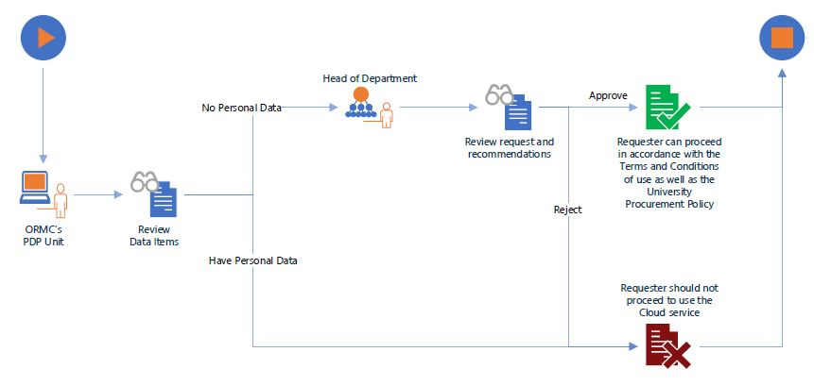
Full Cloud Assessment Routing and Approval Process
Case 1: Unclassified or Non-NUS Data
Submission of new cloud assessment/re-assessment request
with data classification of:
Unclassified data
Non-NUS data
Notes:
There are 3 different routing and approval processes. Let’s begin with the simplest for Unclassified and Non-NUS Data.
After a full cloud assessment request is submitted, [CLICK], it is routed to the ORMC’s PDP Unit for the review of data items declared.
[CLICK] If PDP confirms there is “No Personal Data”, the request is routed to the HoD for approval.
[CLICK] If the HoD approves, the requestor is notified of the successful assessment and may proceed in accordance with the NUS defined Terms & Conditions of use as well as the University Procurement Policy.
[CLICK] [CLICK] However, if either “Personal Data” is involved or the HoD rejects the cloud assessment, the requestor is notified of the unsuccessful assessment.

Slide 17
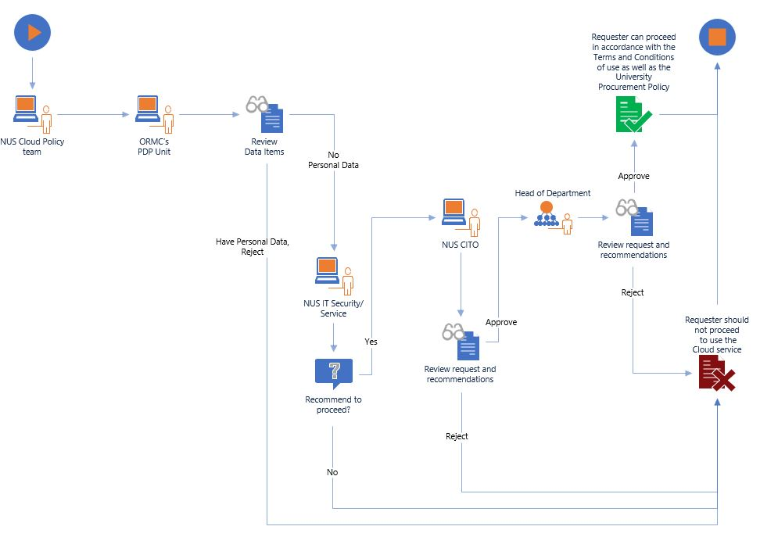
Full Cloud Assessment Routing and Approval Process
Case 2: NUS Confidential without Personal Data, or NUS Restricted
Submission of new cloud assessment/re-assessment request
with data classification of:
NUS Confidential without Personal Data
NUS Restricted data
Notes:
Moving on to the 2nd type of routing and approval process, for NUS Confidential without Personal Data and NUS Restricted data.
[CLICK] Upon receipt of a full cloud assessment request, the cloud policy team performs a sanity check on the submission. If there is an issue on the submitted information, the cloud team contacts the requestor to furnish more information for the assessment.
[CLICK] Next, the PDP ascertains if there truly is no personal data involved.
[CLICK] If PDP confirms there is “No Personal Data”, the request is routed to the NUS IT Security/Service for IT review.
[CLICK] If the IT review passes, the request is routed to the CITO
[CLICK] If the CITO approves, the request is routed to the HoD for approval
[CLICK] If the HoD approves, the requestor is notified of the successful assessment and may proceed in accordance with the NUS defined Terms & Conditions of use as well as the University Procurement Policy.
[CLICK] [CLICK] However, during the PDP and IT review stages as well as HoD’s approval stage, if any of the party rejects the cloud assessment, the requestor is notified of the unsuccessful assessment.

Slide 18
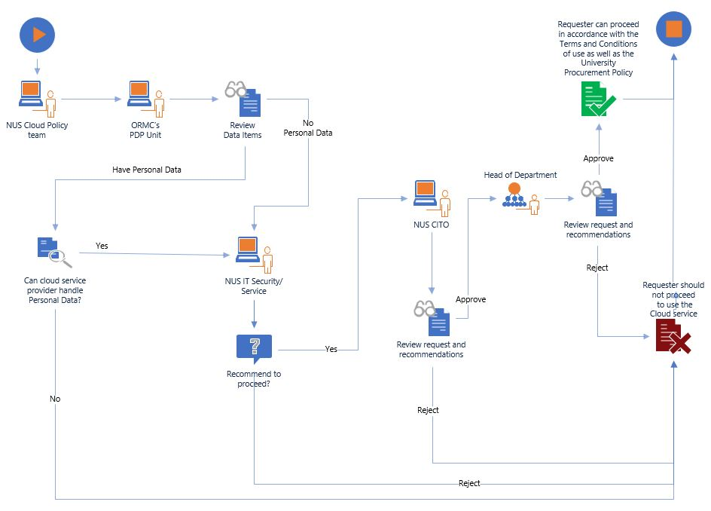
Full Cloud Assessment Routing and Approval Process
Case 3: NUS Confidential with Personal Data
Submission of new cloud assessment/re-assessment request with
data classification of:
NUS Confidential with Personal Data
Notes:
Moving on to the last type of routing and approval process, for NUS Confidential with Personal Data.
[CLICK] Upon receipt of a full cloud assessment request, the cloud policy team performs a sanity check on the submission. If there is an issue on the submitted information, the cloud team contacts the requestor to furnish more information for the assessment.
[CLICK] Next, the PDP ascertains if personal data is involved
[CLICK] If there is Personal Data, PDP further reviews if the cloud service is appropriate to manage personal data.
If either PDP passes the review [CLICK] or there is no personal data involved, …
[CLICK] the request is routed to the NUS IT Security/Service for IT review.
[CLICK] If the IT Security/Service passes the IT review, the request is routed to the CITO
[CLICK] If the CITO approves, the request is routed to the HoD for approval
[CLICK] If the HoD approves, the requestor is notified of the successful assessment and may proceed in accordance with the NUS defined Terms & Conditions of use as well as the University Procurement Policy.
[CLICK] [CLICK] However, during the PDP and IT review stages as well as HoD’s approval stage, if any of the party rejects the cloud assessment, the requestor is notified of the unsuccessful assessment.

Slide 19
NUS Cloud Assessment
FAQ
Who is responsible to determine NUS data classification of University data?
In accordance with the NUS Data Management Policy, it is the responsibility of the Data Steward of a department. Please refer to the policy for more information.

Slide 20
NUS Cloud Assessment
FAQ
How long will it take to complete a submitted cloud assessment?
It depends on its submitted data classification.
The duration to complete the review of a cloud assessment could take:
as fast as within a week
(for data classification = Unclassified),
or as long as 2 to 3 months
(for data classification = NUS Confidential/NUS Restricted
and how fast the CSP could furnish the required
information to the reviewers’ questions)

Slide 21
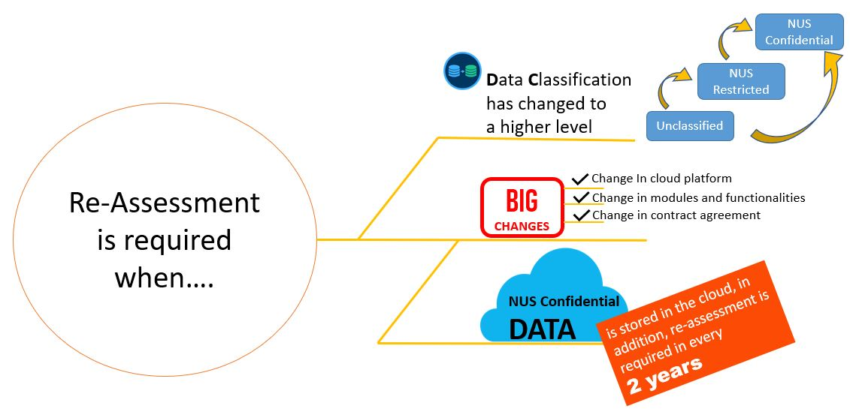
NUS Cloud Assessment
FAQ
When do I need to submit the approved cloud solution for re-assessment?

Slide 22
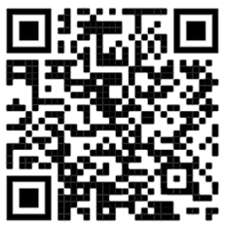
NUS Cloud Assessment
Please provide your feedback
QnA
https://nus.syd1.qualtrics.com/jfe/form/SV_cxc8h35qH67PSKO?Topic=T26102022
NUS nCloudAssess App - https://nusit.nus.edu.sg/cloud-assessment/nCloudAssess
For NUS cloud assessment enquiry, please email to NUSCloudPolicy@nus.edu.sg

Slide 23
Thank
you
Notes:
Thank you for staying till the end of the video. We hope you have gained a better understanding of the NUS Cloud Assessment.

